Slide 1
Creating Forms with HTML
What are Html Forms
The Button Element
Creating a Selection List
Adding Radio Buttons and Check Boxes to a Web Page
Uploading files with fileupload
Accessing Text with the Text Controls
Creating Interpage Persistance with the hidden element
Submitting and Resetting the Form with submit and reset
Working with the new HTML 4.0 Form Elements and Extensions

Slide 2
What are HTML forms?
An HTML form is not a visual element.
It is a container and can contain one or more buttons, textboxes or other form elements.
The form elements can be used to access information from the reader and then process that information within the webpage.
The information can also be sent to a CGI or web server application for further processing.

Slide 3
The FORM Objects and its Attributes
A form is created using the begin and end form tags <FORM> and </FORM>.
Though not required , there are form attributes that can control what happens to the information, the method used to deliver this information and where feedback derived from the form contents should be sent.
Syntax for Creating Form
<Form name=“mailForm”
action = “url” Method=post>
……
</Form>

Slide 4
Form attributes are:
i. name – Form name.
ii. target – Location of window where from responses are sent.
iii. action – URL of webserver application that process form information.
iv. enctype – By default this attribute has a value of application x/www- form-urlencoded, but can be set to multipart/form-data if the file upload element is used. Not all browsers support the latter encoding type.
v. method – A value of get or post, which determines how form information is sent.

Slide 5
The forms array
Each form has a separate entry in a built-in array called forms.
This array can be accessed in script through the document object, which contains this array as a property.

Slide 6
Web page with 2 forms and 4 elements
<html>
<head>
<title>forms</title>
<script language="javascript">
<!--
function list_values()
{
var string="";
for(i=0;i<document.forms.length;i++)
{
string+="form name: "+document.forms[i].name+"<br>";
for(j=0;j<document.forms[i].elements.length;j++)
string+=document.forms[i].elements[j].name+" ";
document.forms[i].elements[j].value+ "<br>";
string+="<p>";
}
document.writeln(string);
}
-->

Slide 7
Web page with 2 forms and 4 elements(contd.)
</script>
function
</head>
<body>
<!--form 1 -->
<FORM name="form1">
<input type=text name="textname">
<input type=button name="button1" value="push me">
</FORM>
<!--form 2-->
<form name="form2">
<select name="randomvalues">
<option value="1">one
<option selected value="2">Two
</select>
<input type=button name="button2" value="no, push me" onclick="list_values()">
</form>
</body>
</htmL>

Slide 8
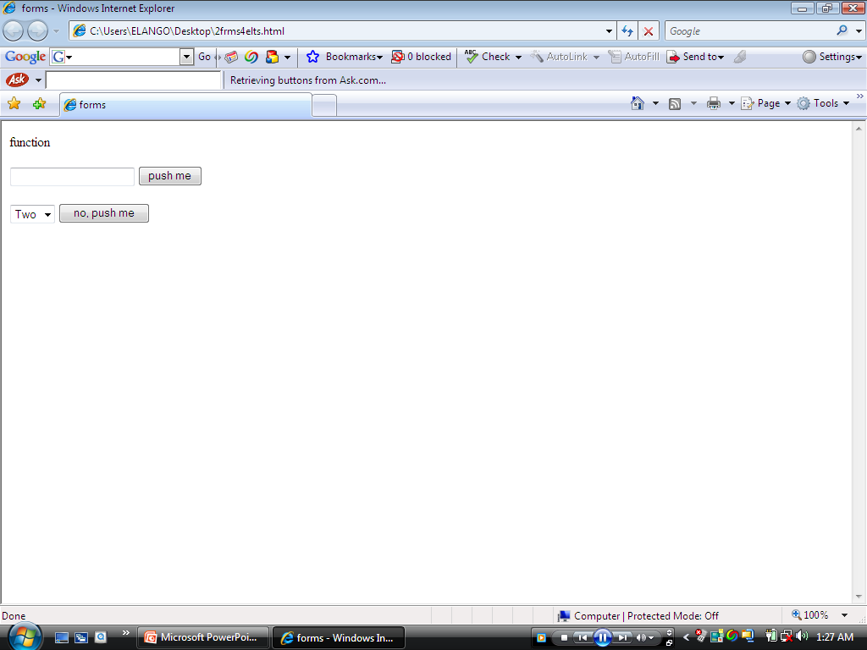

Slide 9
The FORM elements
The Form elements are : button, check box, fileupload, hidden, password, radio, reset, select, submit, text and textarea.
Each element has a different look and performs a different function.
The INPUT tag creates most of these elements. As an example of creating an element, the following code creates a text field:
<INPUT type=“text” name=semefield>

Slide 10
The BUTTON Element
Probably the most common of the form elements is the button element.
You can create a button using the following code
<input type=“button” name=“somebutton” value=“PUSH ME”>

Slide 11
A simple form , button with the words “push me”
<html>
<head>
<title>but</title>
</head>
<body>
<input type="button" name="somebutton" value="push me">
</body>
</html>

Slide 12
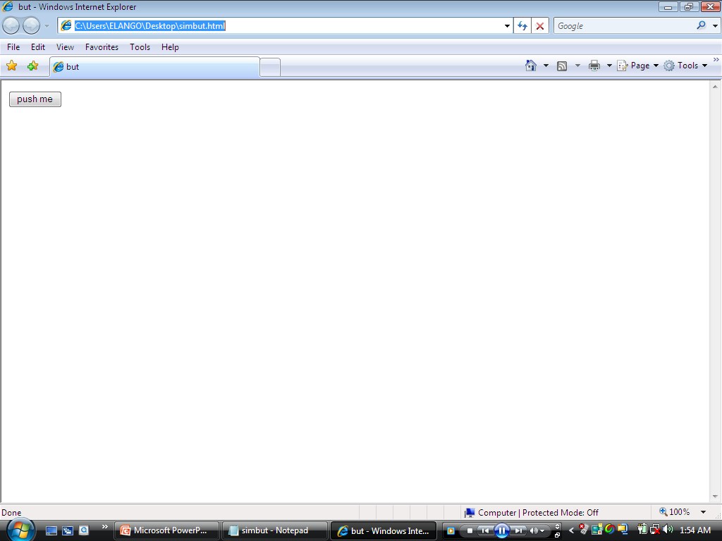

Slide 13
Applying CSS1 style sheets to several buttons
<html>
<head>
<title> buttons</title>
<style type="text/css">
#one{color: red; font-weight: bold}
#two{color: darkgreen; font-weight: bold; background-image: url(C:\Users\Public\Pictures\Sample Pictures\forest.jpeg); width:200; height:150}
#three{color: firebrick; background-color: ivory; border-color: firebrick; font-family: chiller}
#four{color: white; background-color: blue; border-color: yellow; border-style: groove; border-width:10; width:200}
#five{text-decoration: underline; background-color: green; color: lime}
</style>
</head>

Slide 14
Applying CSS1 style sheets to several button(contd.)
<body>
<!--form 1-->
<form name="form1">
<!--button 1-->
<input id="One" type=button name="button1" value="push me">
<!--button 2-->
<input id="Two" type=button name="button1" value="push me">
<!--button 3-->
<input id="Three" type=button name="button1" value="push me">
<!--button 4-->
<input id="Four" type=button name="button1" value="push me">
<!--button 5-->
<input id="Five" type=button name="button1" value="push me">
<!--button 6-->
<input type=button name="button" value="push me">
</form> </body> </html>

Slide 15
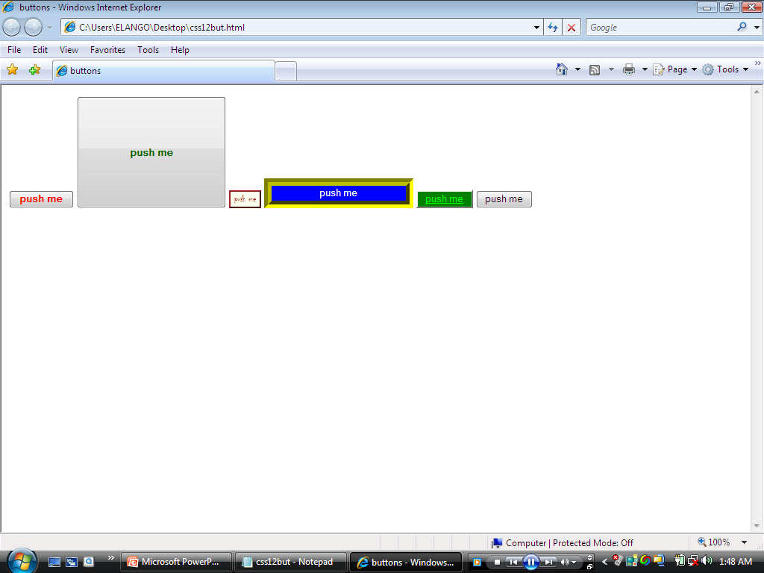

Slide 16
Creating a SELECTION list
A selection list, or drop-down list box is really a couple of different element.
The first is the select element, which is the box, and the second is one or more option elements, which contain the box entries.
Creating a selection list generates a text-field-sized element with an arrow.
Clicking the down arrow in the box next to the list exposes the list elements in a drop-down box big enough to hold all the elements.

Slide 17
Web page showing selection list with four option
<html>
<head>
<title>but</title>
</head>
<body>
<select name="selection">
<option> ONE
<option> TWO
<option selected> THREE
<option> FOUR
</body>
</html>

Slide 18
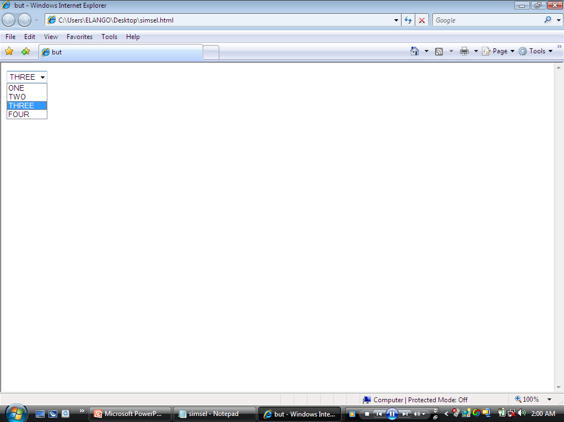

Slide 19
Creating a SELECTION list (contd.)
There are three attributes for the SELECT object:
name – element name.
size – number of options visible when page opens, set to one by default.
multiple – specifies that more than one option can be selected.

Slide 20
Applying CSS1 attributes to a select and option elements
<html>
<head>
<title>list</title>
<style type="text/css">
option {background-color: lime; color: red}
option.two{background-color: blue; color: yellow}
select{background-color: red; margin: 1.0in; font-family: algerian; font-weight: bold;font-size: 18pt}
</style>
</head>
<body>

Slide 21
Applying CSS1 attributes to a select and option elements(contd.)
<!--form 1-->
<form name="form1">
<select name="selection">
<option value=1> First selection
<option class=two value=2> Second selection
<option value=3 selected> Third selection
<option class=two value=4> Fourth selection
</select>
</form>
</body>
</htmL>

Slide 22
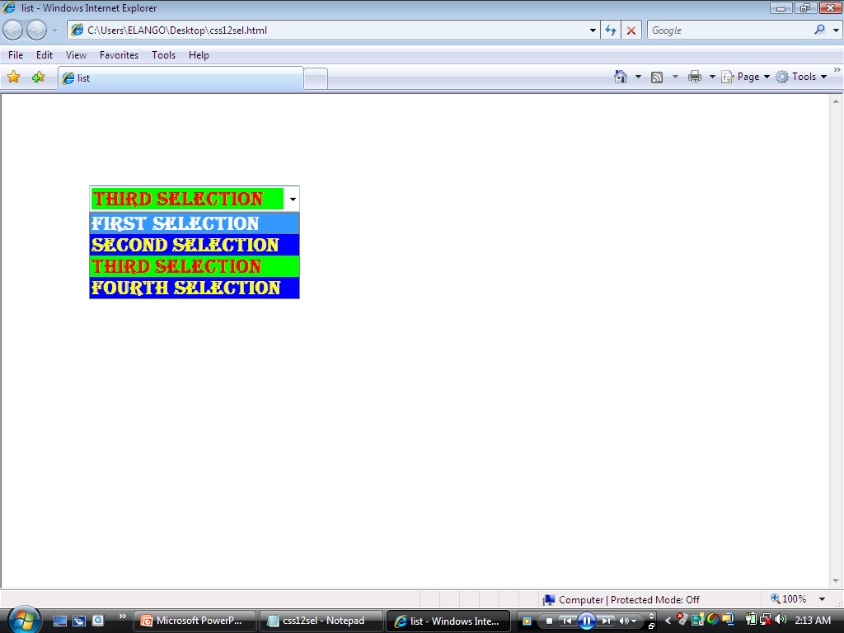

Slide 23
Adding Radio Buttons and Checkboxes to a webpage
The radio button is a way to provide a set of mutually exclusive choices.
Only one button can be checked with the radio button, and clicking one of the buttons deselects any previous selection.
Checkboxes, on the other hand , provide a method of selecting several mutually inclusive choices.
You can select one box or more of the options represented by the boxes.

Slide 24
A web page with three related radio buttons and three check boxes
<html>
<head>
<title>but</title>
</head>
<body>
<!--radio buttons-->
<input type="radio" name="thegroup" value="one" checked>one
<input type="radio" name="thegroup" value="two" >two
<input type="radio" name="thegroup" value="three">three
<p>
<!--checkboxes-->
<input type="checkbox" name="ckhbox1" value="checkone" checked>check one
<input type="checkbox" name="ckhbox2" value="checktwo">Two
<input type="checkbox" name="ckhbox3" value="checkthree">three
</body>
</htmL>

Slide 25
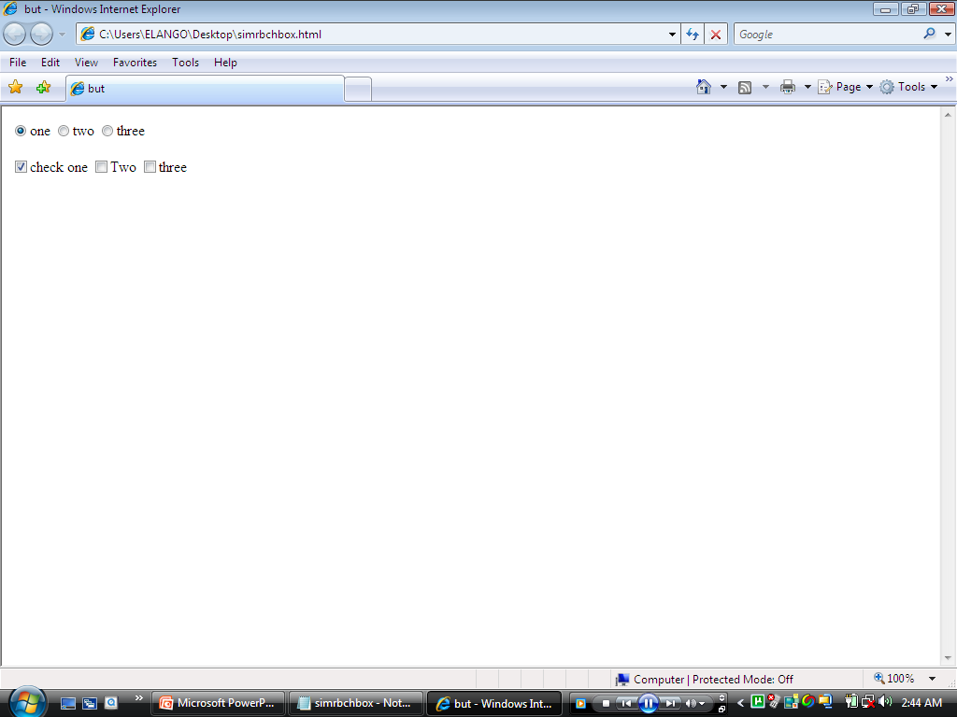

Slide 26
Uploading files with fileupload
The fileupload element provides a means for the web page reader to specify a file for loading to the web server.
When you create one of these controls, a textbox for the filename and a button labeled browse… are created within the webpage.
The web page reader can type a filename and path into the box or click the browse button to select a file.
When the form is submitted, the file is also appended to the form data being sent to the server.

Slide 27
Accessing Text with the Text Controls: text, text area and password
The text, text area and password input elements are all methods of accessing text from the web page reader.
The text element provides for single-line text values such as a name, and text area provides a control that can accept a block of text several words wide and several lines long.
The password element hides the values being entered with the usual display of asterisks.

Slide 28
Three HTML input elements , a text control,a textarea control and a password control
<html>
<head>
<title>text</title>
</head>
<body>
<input type="text" value="Enter information here" name="text1" size=80>
<p>
<textarea rows=20 cols=50></textarea>
<p>
<input type="password" size=20>
</body>
</htmL>

Slide 29
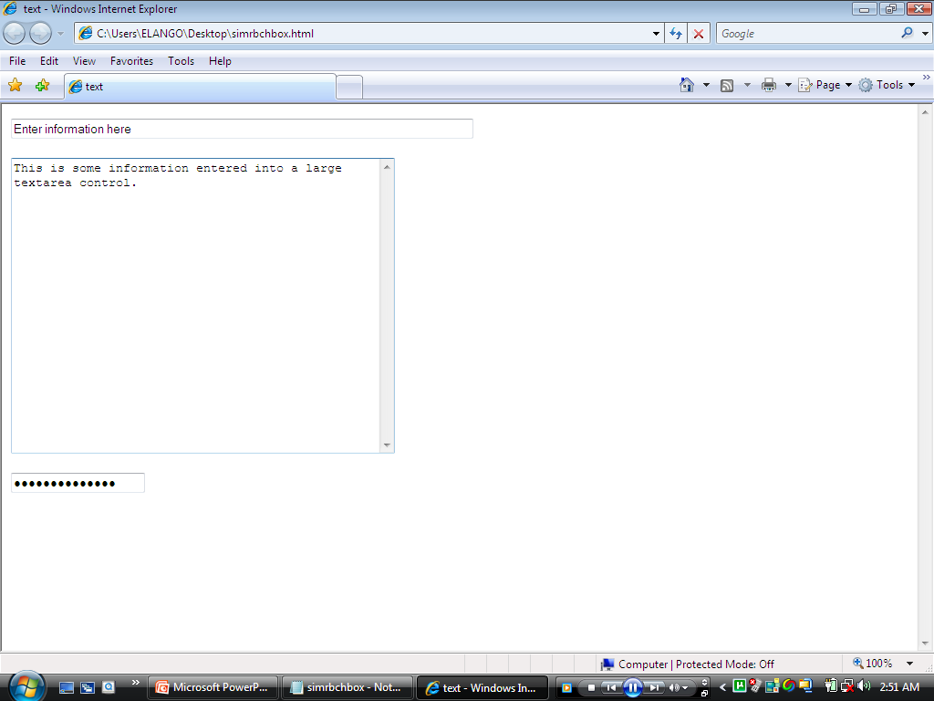

Slide 30
Creating Interpage Persistence with the hidden Element
There is a great trick to use when maintaining information persistently between the webserver application and the web pages showing on the client.
This technique is accomplished using the hidden form elements.
The hidden form element is an element that contains information stored within the web page but not displayed to the web page reader.

Slide 31
A web page with a hidden text
<html>
<head>
<title>but</title>
</head>
<body>
<input type="hidden" name="somevalue" value="The hidden text">
</body>
</html>

Slide 32
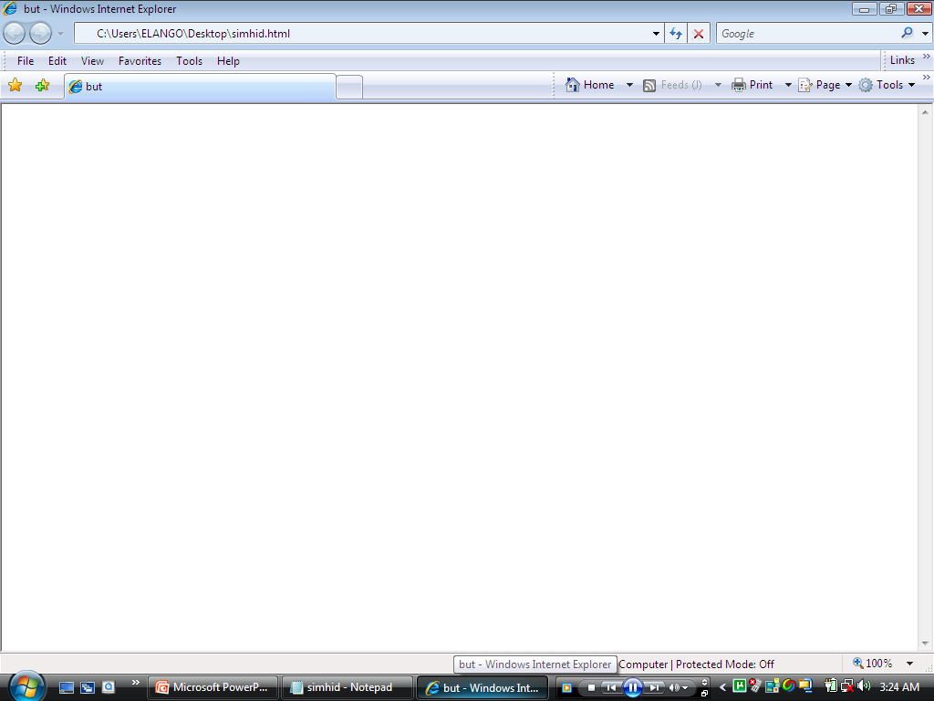

Slide 33
Submitting and Resetting the form with submit and reset
These two INPUT elements submit the form to the form processing application , or reset the form values, respectively.
To create either of these elements, the following code is used,
<INPUT TYPE=“submit” VALUE=“Send Form”>
<INPUT TYPE=“reset” VALUE=“Reset Form Value”>

Slide 34
Submitting and Resetting the form with submit and reset(contd.)
Using the submit element submits the form.
An alternative approach could be to create some other element , and based on trapping an element event, issue the form submit method, as shown here:
document.forms[0].submit();
document.forms[0].reset();

Slide 35
A web page with simple submit & reset elements
<html>
<head>
<title>but</title>
</head>
<body>
<input type="submit" value="Send Form">
<input type="reset" value="Reset Form Values">
</body>
</htmL>

Slide 36
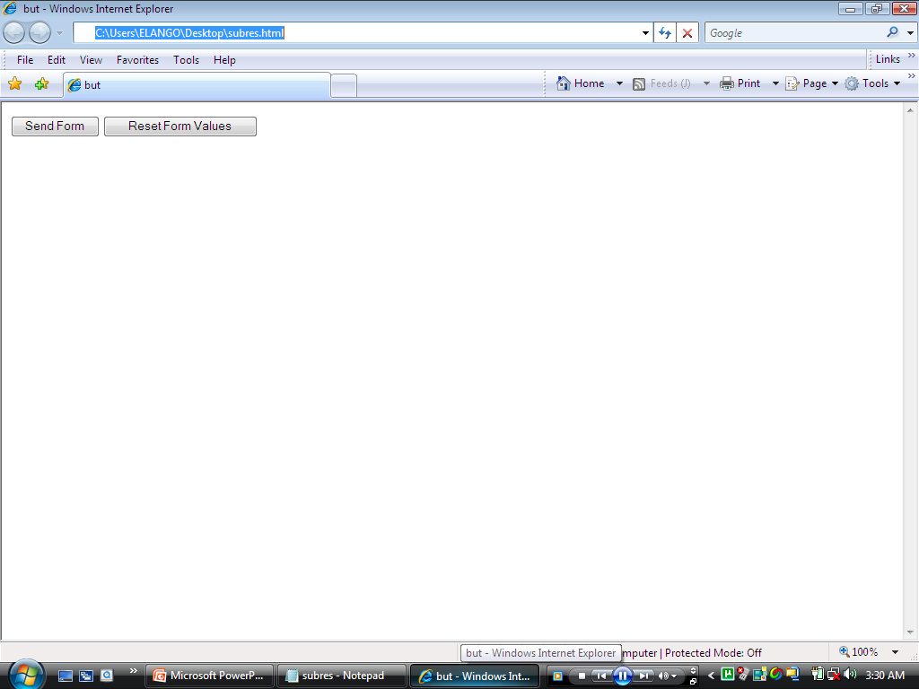

Slide 37
Working with the New HTML 4.0 form Elements and Extensions
The HTML 4.0 has several new form elements and form element attributes.
Label, image and fieldset are the three new HTML 4.0 form elements.
>> The label element is used to provide a label for a control, such as the text or text area controls.
>> The image control creates an image-based control that can be clicked in a manner similar to a button.
>> The fieldset control is an element that provides a visual grouping of other form elements,such as radio buttons.

Slide 38
Working with the New HTML 4.0 form Elements and Extensions(contd.)
Accesskey, tabindex, disabled and read only are the new HTML 4.0 element attributes.
The accesskey attribute can be used to associate an accelerator key with a specific form element.
The disabled attribute disables the focus from an element and prevents that same element’s value from being submitted with the form.
The tabindex attribute associates a specific tab order with an element.

Slide 39
Working with the New HTML 4.0 form Elements and Extensions(contd.)

